Slide 1
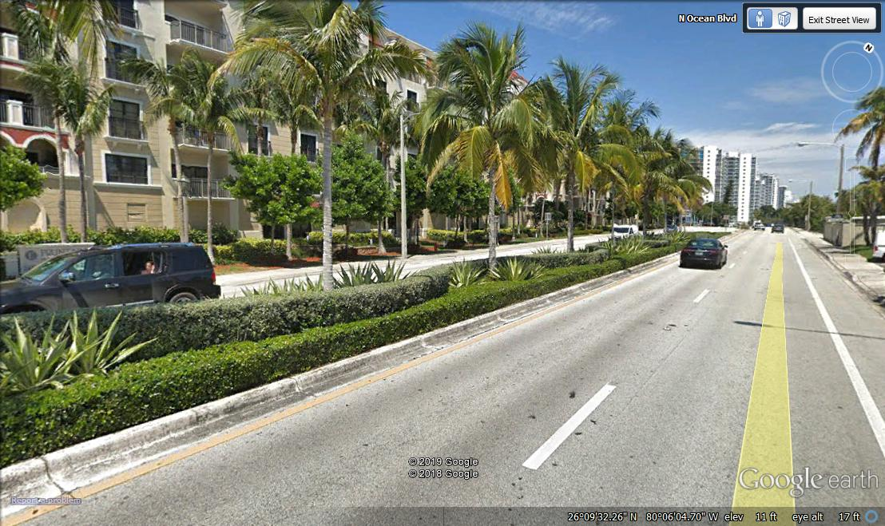
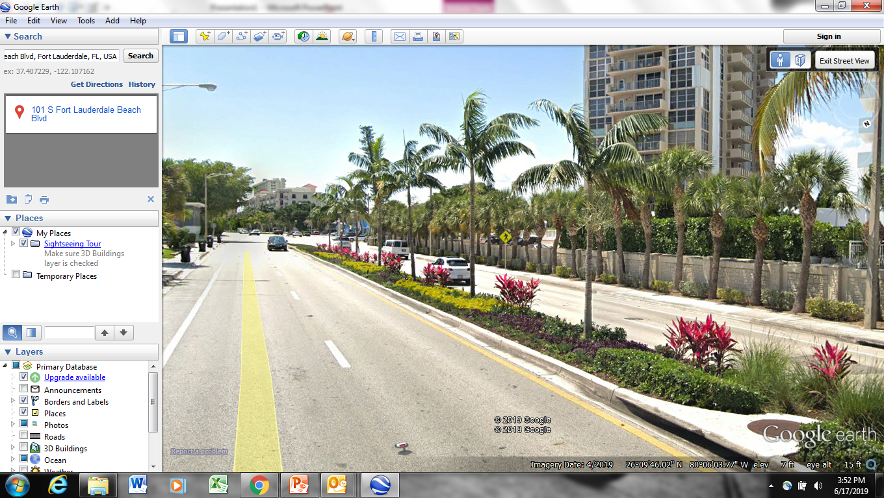
Sunrise blvd
would reflect this look

Slide 2
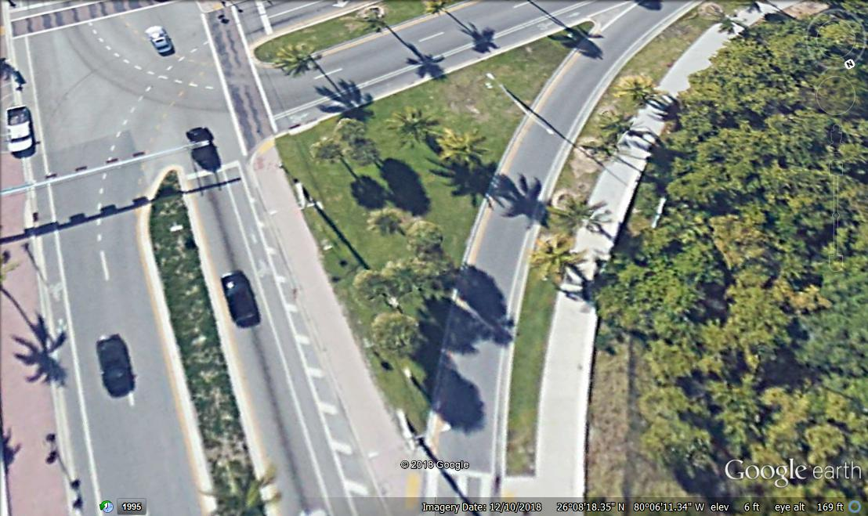
Sunrise blvd
A1A
Green Island Ficus
Pink Pentas
Gold Mound
Hawaiian Ti Plant
Muhly Grass
Silver Buttonwood

Slide 3
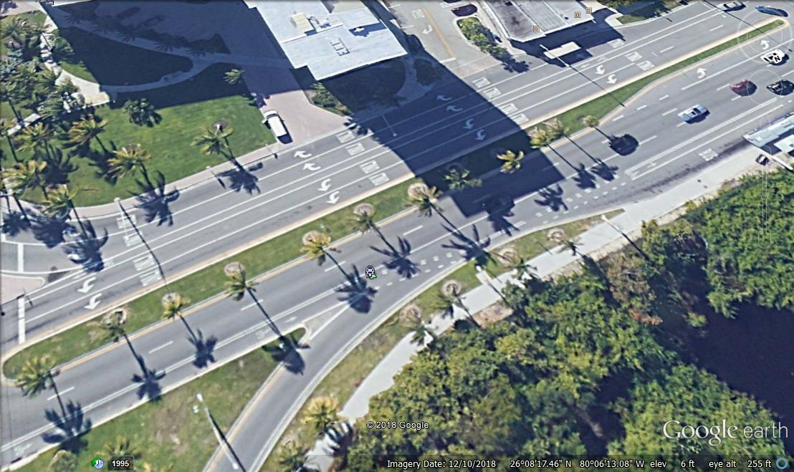
Green Island Ficus
Pink Pentas
Gold Mound
Hawaiian Ti Plant
Muhly Grass
Silver Buttonwood

Slide 4
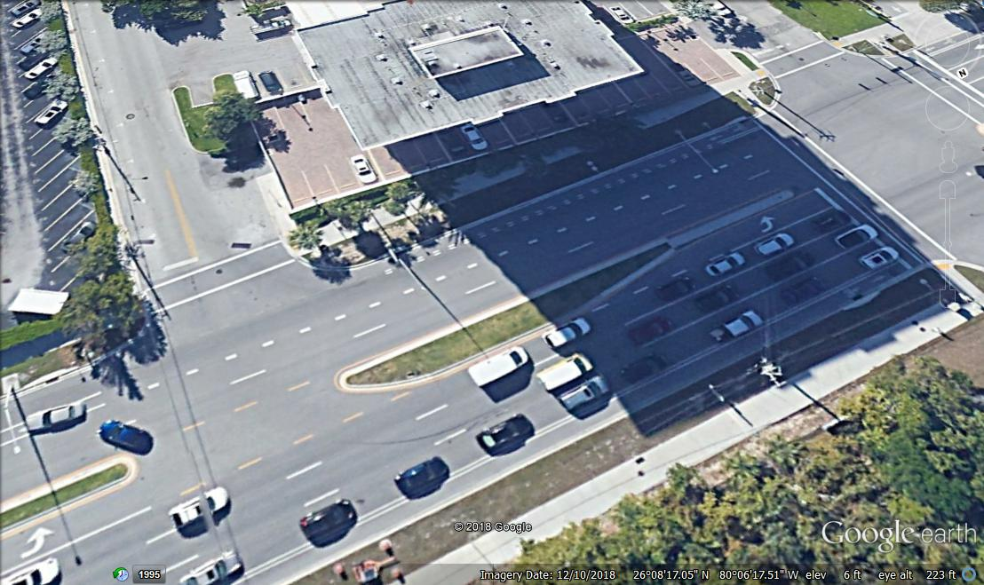
Green Island Ficus
Pink Pentas
Gold Mound
Hawaiian Ti Plant
Muhly Grass
Silver Buttonwood

Slide 5
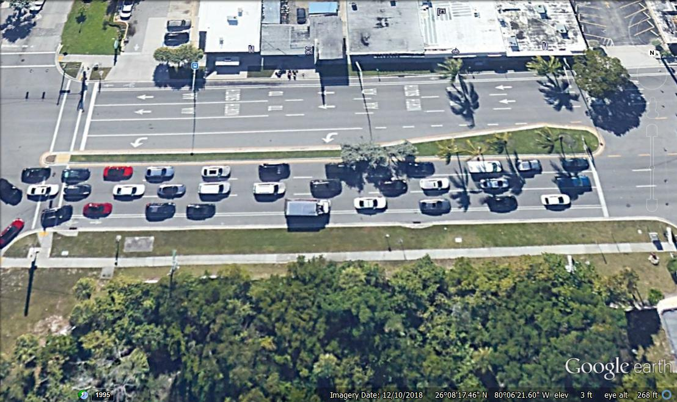
Green Island Ficus
Pink Pentas
Gold Mound
Hawaiian Ti Plant
Muhly Grass
Silver Buttonwood

Slide 6
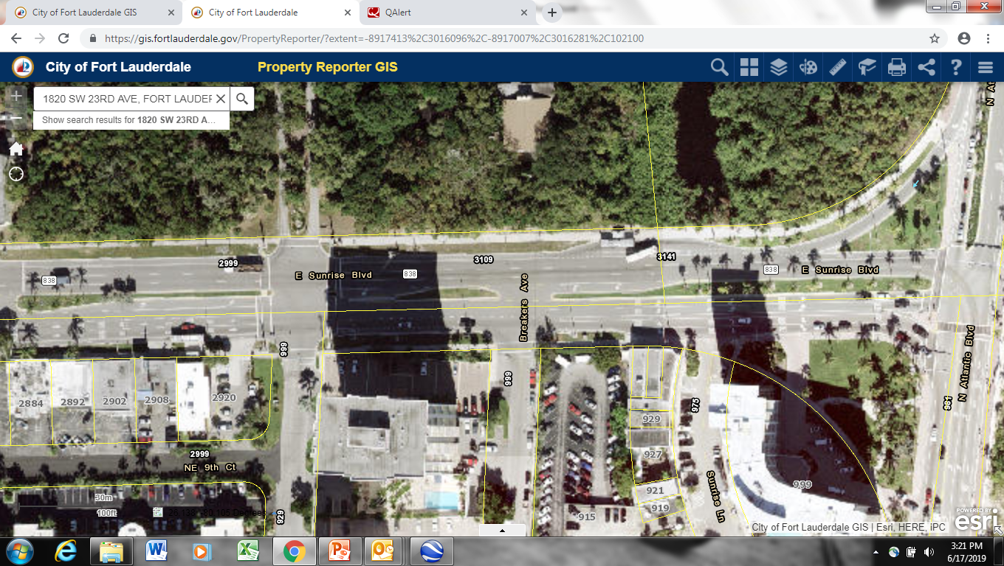
6000 sf
1100 sf
6500 sf
3000 sf
Total = 16, 600 sf
16,600 x $6.95/sf = $115,370 for plant material
$20,000 for soil prep
$10,000 for irrigation
repairs and upgrades to
median plant heads
Total - $145,370

