Slide 1
Ft. Lauderdale Aquatic Center
South Building Update
October 2019 Original Rendering

Slide 2
July 2020 Updated Rendering w/ North Building & 27M Tower

Slide 3
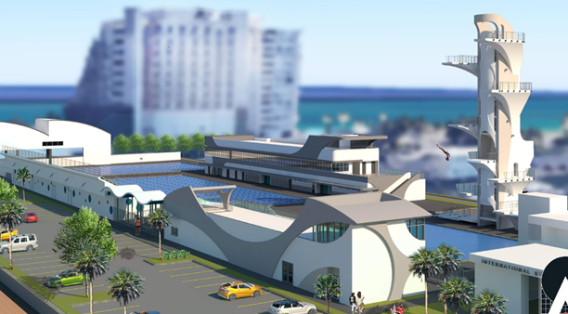
December 2020 Updated Rendering w/ South Building

Slide 4
Ft. Lauderdale Aquatic Center
South Building Timeline Update
May 2019
COFL Approves HP to Research “renovation” Options to South Building
Oct. 2019
HP Submits Unsolicited Proposal October 2019
Dec. 2019
Proposal Formally Accepted December 2019
May 2020
Interim/Comp Agreement Negotiations Commence May 2020
Aug. 2020
Interim Agreement Executed August 2020
Sep.–Nov. 2020
Design September 2020- November 2020
Dec. 2020
Pricing of 60% Design Package December 2020
January 2021
December 2020 – January 2021 Continue to research VE’s

Slide 5
Ft. Lauderdale Aquatic Center
Cost Increases vs Initial Assumptions
$550, 000 Site Work - Unable to reuse existing underground utilities as initially assumed along with relocating stadium lighting poles
$790,000 Additional Program Square Footage - Increase in bldg size to accommodate all programs & end users along with enhanced façade features
$730,000 HVAC, Elect. & Plumbing Systems - Increase in AC demand for larger bldg. along with more efficient systems
$630,000 Construction GC/GR’s - General Contractor staffing, General Requirements and General Conditions
$800,000 COFL Costs - IT Equipment, FF&E, Permit Fees, Threshold Inspections

Slide 6
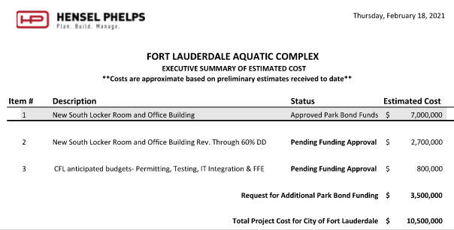
Ft. Lauderdale Aquatic Center
Overall Executive Summary

Slide 7
Phase One Plan For Early Turn Over of Dive Pool & Training Pool
Inside the blue brackets will be construction personal only in an early turn over scenario for the dive pool and training pool

Slide 8
New Grandstand Bleacher Building w/
Pumps/Filters
Pool Equipment
FPL Vault
Repair Existing Training Pool
New Competition Pool
New
Surface Parking lot
New
Pool Deck
Existing South Building to be Demolished & Replaced
New 2 Story Bldg w/
Ticket/Concessions
Bathrooms
Elevator
Storage
Lvl 2 is an open air amenity deck
New
27M Dive
Tower
New
Dive
Pool
Aerial Photo Taken 1/21/2021 – Looking East

Slide 9
Construction of the New 2 Story South Building will be 18’ from the Competition and Training Pools . Plaster, tile and bulkhead will pause until the South Building is Complete with structural & exterior works.
Aerial Photo Taken 1/21/2021 – Looking South

Slide 10
South Building
Feb. 2021
COFL Request Additional Funds
March-April 2021
May 2021
COFL Budget Transfer
Comp Agreement Executed
May 2021 – Feb 2022
Phase 1 Const. Complete
Early Open to Training & Dive Pool
COFL Public Hearing
COFL 2 Readings
Demo Permit
Master Permit
Feb 2022-July 2022
Phase 2 Const Complete
Open Comp Pool & South Building
Notes:
KC

Slide 11
FLAC & S Bldg Overlap
August 2021
Nov. 2020
Feb 2022 First Swim TP/DW
FLAC Overall Time Left
* Time For Remaining FLAC Work To Complete Follow-on S Bldg Work:
Pool Plaster, Pool Deck, Entrance Canopy, Flag Poles, Scoreboard and etc.
Dec 2021 – Feb 2022
Building A
Building B
Pool Deck
27M Tower
Dec. 2020
Parking Lot
*
March 2021
Design
May 2021
Pricing Conf.
Sept. 2021
Permitting
Feb 2022 First Swim TP/DW
Comp. Agreement
July 2022
Complete Turnover
Demo
Structure
May 2021 COMP agreement in place to support start of structure in September 2021
Skin/Roof/Glazing
Interior Build Out
TAB/Final Insp
Notes:
KC

Slide 12
Ft. Lauderdale Aquatic Center
South Building
Questions ?

