Slide 1

Men’s Health
Wendy Petusevsky, RD, Diabetes Educator
Jessica Roark, MPH, ACSM CPT

Slide 2



Objectives
Learn Men’s Heath Risk
Lifestyle tips to assist with Prevention
Notes:
This presentation is designed to educate you on the importance and awareness of men’s health; focuses on the screening aspect,

Slide 3

Quiz: Men’s Health
Notes:
We are going to kick off the presentation with a little quiz to help test your knowledge and give an additional sneak peak of what we will be reviewing today.

Slide 4
Question 1
Adult men should get 15 minutes of moderate intensity exercise most days of the week?
  True
  False

Slide 5
Question 1
Adult men should get 15 minutes of moderate intensity exercise most days of the week?
  True
  False
Notes:
False - It is recommended that you should get at least 30 minutes of moderate-intensity exercise most days of the week.

Slide 6
Question 2
Men are more likely to attempt suicide.
  True
  False

Slide 7
Question 2
Men are more likely to attempt suicide.
  True
  False
Notes:
False - Women are three times more likely to report attempting suicide than men. However, men are four times more likely to actually die from suicide.

Slide 8
Question 3
More men die from prostate cancer than any other cancer.
  True
  False

Slide 9
Question 3
More men die from prostate cancer than any other cancer
  True
  False
Notes:
More men and women die from lung cancer than from any other type of cancer. Quit smoking and avoid secondhand smoke to lower your risk for lung cancer, disease, and other diseases and conditions. Prostate cancer is the second leading cause of cancer deaths in men.

Slide 10
Question 4
Unlike women, men don’t require bone density screenings
  True
  False

Slide 11
Question 4
Unlike women, men don’t require bone density screenings
  True
  False
Notes:
False - Men also lose bone density as they get older, so screening is recommended for most men after the age of 65.

Slide 12
Question 5
A blood pressure reading 120/80 is considered
  Pre-hypertension
  Normal
  Too low

Slide 13
Question 5
A blood pressure reading 120/80 is considered
  Pre-hypertension
  Normal
  Too low
Notes:
B) Normal. A blood pressure reading below 120/80 is considered normal. In general, lower is better. However, very low blood pressure can sometimes be a cause for concern and should be checked out by a doctor

Slide 14

How did you do?

Slide 15

Men’s Health Month
The goal is to raise awareness about preventable health problems and encourage early detection
Ways to celebrate/increase awareness
  Wear blue
  Schedule your screening today
  Set a new lifestyle goal
  Share what you learned with men in your life today!
Notes:
Encourage the men in our lives to take care of their bodies by eating right, exercising and working to prevent disease!

Slide 16
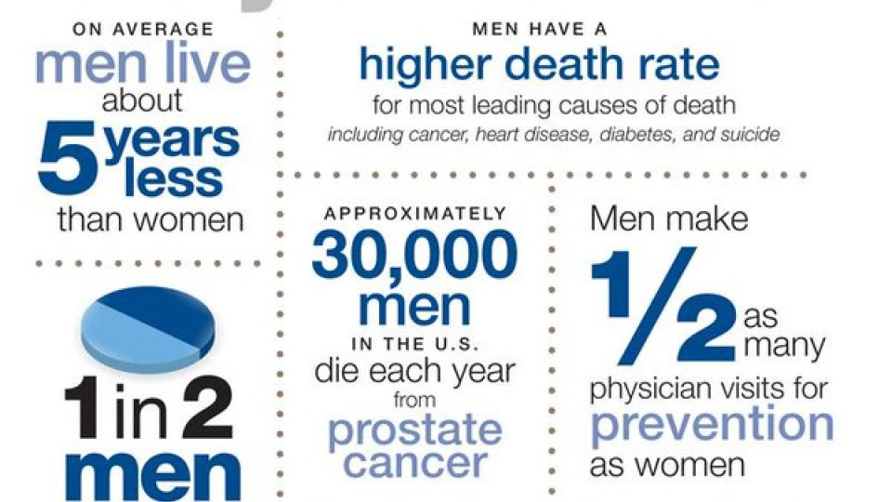
Why Important?
Notes:
According to the CDC, the average lifespan for men is about five years less than women, and over the years there has been a gradual increase in this gap.
The top three causes of death for men include heart disease, cancer, and unintentional injuries.
Men are almost twice as likely as women to die of a heart attack and significantly more likely to die of cancers as compared to women.
Men are also less likely to undergo treatment for mental health conditions such as depression, resulting in nearly a 4x increased likelihood of committing suicide.

Slide 17
Top Excuses to Avoid Doctor Visits
“I am healthy – there’s no reason for me to go to the doctor”
“I have no time”
“If I don’t go, I won’t find anything wrong with me”
“I am afraid of finding out that something is wrong with me”
“I don’t need to go until I’m older”
Have you said any of these yourself?

Slide 18

Screenings
Blood pressure screening
Cholesterol
Colorectal Screening
Diabetes screening
Hepatitis B
Hepatitis C
PSA
Weight/Height
Depression screening
Routine screening tests for men - Harvard Health
Notes:
Others include:
STIs/STDS
Skin Cancer
Lung

Slide 19

What are stigmas associated with men’s mental health?
“You are too emotional”
“Man up”
“Big boys don’t cry”
“I’m not weak”
“We don’t talk about feelings here”
Notes:
There is a strong mental health stigma that men face in society. What are some others men face?
A lot of men have been taught to be leaders and examples in the household, work place, etc. and this has created a space where often mask or “put up a front” true feelings. This can take a toll on mental health over time.

Slide 20

Mental Health
High Stress
Depression high among men
Leading cause of disability
  Underdiagnosed
  Cover it up
Suicide
  8th leading cause of death for men
  75% of suicides are men
Notes:
Depression affects nearly 19 million American adults.
Depression is underdiagnosed in men.
Men are just as likely to be depressed as women, if not more so.
Men are 4x more likely to commit suicide as women.
Depression is the leading cause of disability in the US, sidelining more people than back problems, heart disease, or injuries.

Slide 21
Factors affecting Mental Health
Stress is the body’s response to changing stimuli
Eustress vs. Distress
Stressors
  Death of a loved one
  Divorce of a loved one
  Loss of employment
  The birth of a child
  Being diagnosed with illness
  New job
Notes:
Stress is a factor affecting mental health in addition to stigma.
There are two types of stress; good stress (eustress) and bad stress (distress)

Slide 22
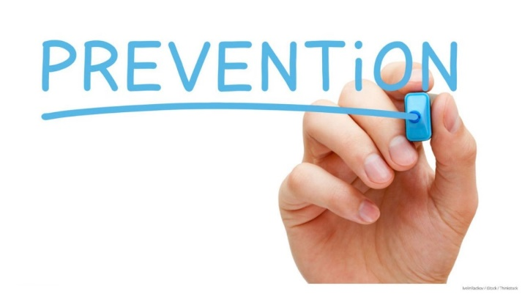
Steps to living a Longer Healthier Life
The key is prevention!
Get an annual exam – visit your provider once a year
  Start early with exams
Know your Numbers – PSA, Cholesterol, Glucose, Blood Pressure
Involve your family in your health
Role model!

Slide 23


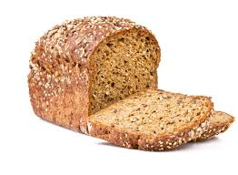


Healthy Eating for Men
Small, sustainable changes
Fruits
  At least two cups of fruits each day
Veggies
  At least 2 ½ cups of vegetables each day
Whole grains
  Replace refined with whole grain
  Brown rice, bread, oats
Fiber
  25 – 34 grams of fiber per day for younger men
  28 grams of fiber per day for men older than 50
Potassium
  from fruits, vegetables, fish, and dairy
Notes:
Over 60 percent of American men are overweight or obese. Americans spend over $30 billion dollars on diet programs each year.
Focus on small, sustainable changes.
For energy and men’s disease prevention, men should eat:
Whole grains such as whole grain pasta, cereal, brown rice, oats, barely, bens, lentils, fruit.
These foods are high in fiber help manage hunger and fullness, and help fend off certain cancers such as prostrate and colon cancer specifically for men.
Potassium – 3,450 mg a day of potassium from fruits, vegetables and fish

Slide 24

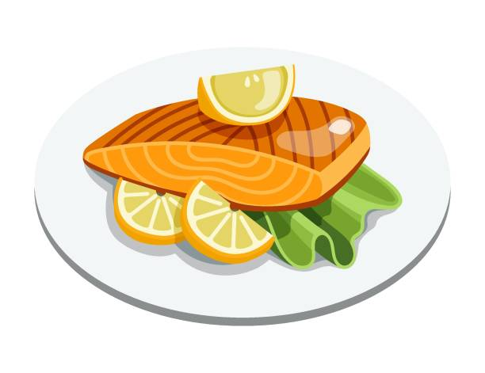

Healthy Eating for Men
Fish
  At least 2-3 servings of fish per week
Meat/Protein sources
  Eat a variety of protein sources
  Chicken, ground turkey, seafood, and plant-based sources such as beans, peas, and soy
  Limit high-fat proteins sources
Heart Healthy fats
  Olive oil, canola oil, nuts, and avocados
Limit
  Limit alcohol intake to 2 drinks or less in a day
  Limit fried foods and saturated fat

Slide 25
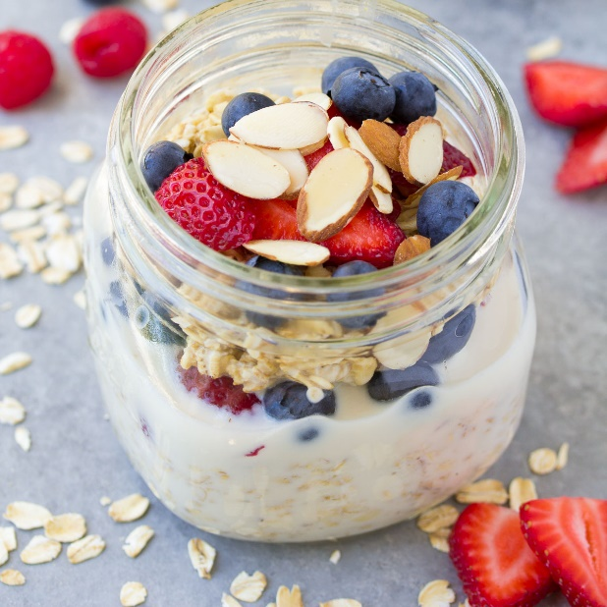
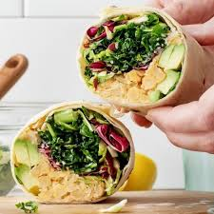
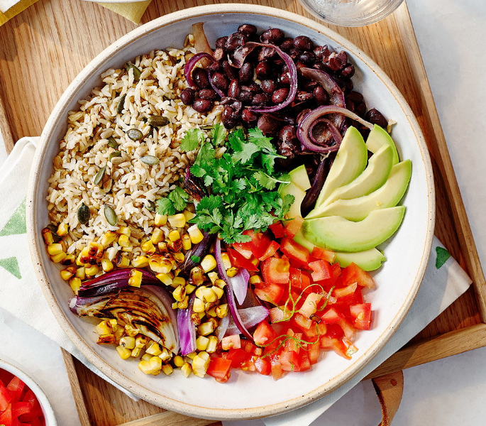
Simple Meals to Support
Notes:
Simple make at home meals to support men’s health (also general health) – take for lunch or make for dinner
These meals are all fairly easy on time, having ingredients at home or keeping them in the pantry, and can easily be modified with different proteins, or different toppings, add-ons, etc.
The ingredients are all foods that support men’s health – whole grains, lean sources of protein, plenty of fiber, etc.
Overnight Oats – Oats, fruit of choice, milk of choice, nuts/seeds for added crunch, protein and satiety
Oats are a great whole grain, nuts/seeds great source of protein to support men’s health
Wraps/sandwiches – Protein of choice (particularly lean, low sodium) – chicken breast, low – sodium turkey, etc., veggies (spinach, romaine, kale, cabbage, etc.), extra flavoring (light dressing, mustard, or herbs to add some flavor
Grain bowl – Brown rice, protein of choice, veggies – corn, tomatoes, cabbage, pickled onion, beans, avocado
Brown rice covers the whole grain, extra veggies, and avocado to support men’s health

Slide 26
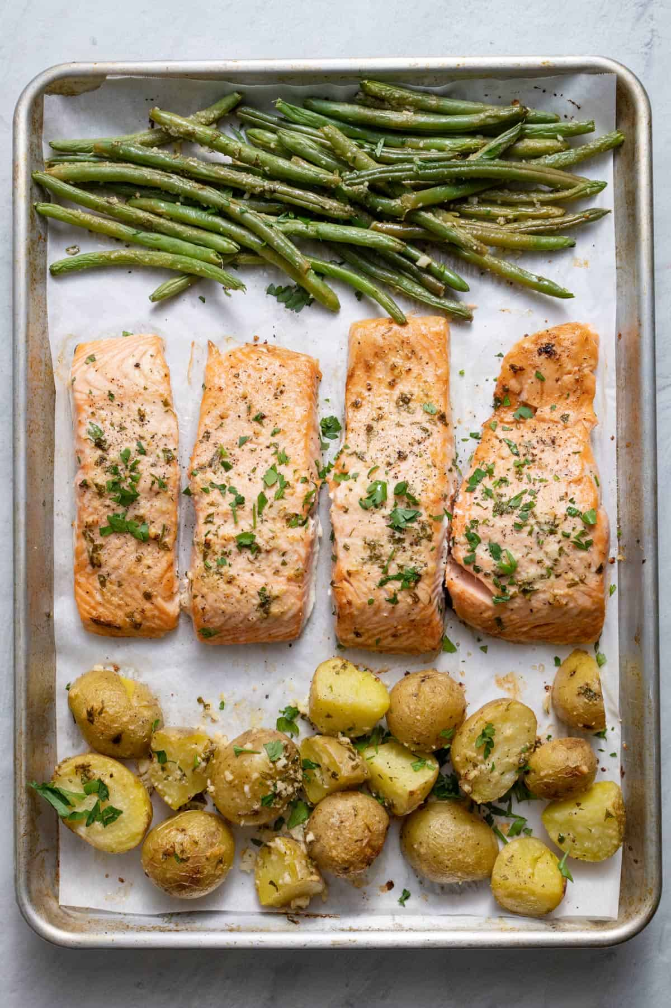
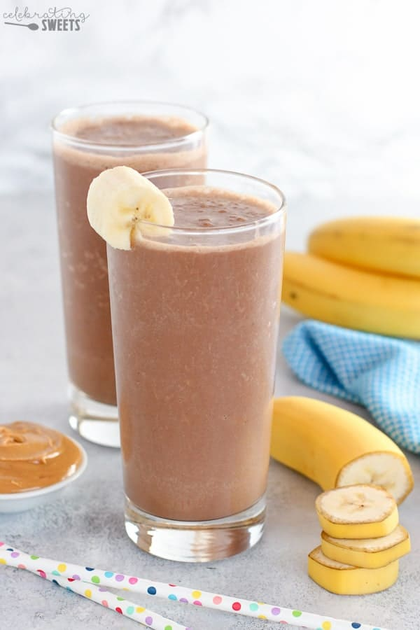

Simple Meals to Support
Notes:
Simple make at home meals to support men’s health (also general health) – take for lunch or make for dinner
Sheet Pan dinners – Protein of choice, add a veggie, and a starch (optional), season with herbs/low-salt seasoning and roast for an easy weeknight meal!
Smoothies – great for breakfast or a snack. Protein, add your fruit of choice, milk of choice, ice, blend
Pizza – Thin whole grain crust, rich tomatoes sauce or a quality pesto, cheese, load up fresh or frozen veggies, add your protein, and don’t forget your herbs or low-salt seasonings for extra flavor.

Slide 27
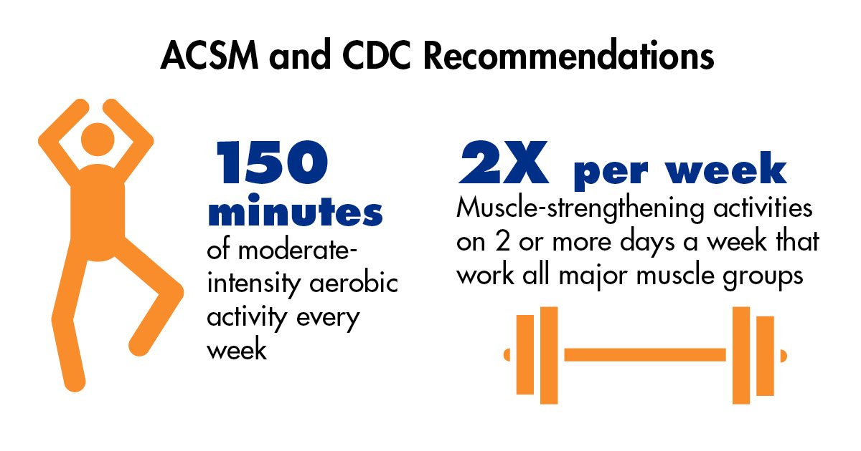
Physical Activity Recommendations
Compound movements
  Squat
  Bench
  Deadlift
  Press
Notes:
Before starting any exercise program, talk to your doctor
ACSM Recommendations
Cardiovascular
Walking, Biking, Running, Dancing, etc.
5 days per week moderate activity of 30 minutes or 3 days per week vigorous of 20 minutes
Strength
Define resistance training
2 days per week; work all major muscle groups
Compound movements!

Slide 28
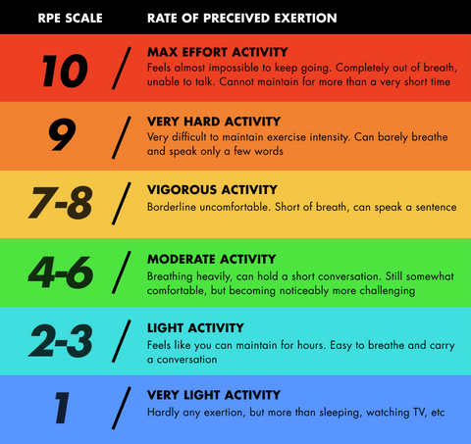
Fitness Recommendations
Notes:
RPE Scale – Rate of Perceived Exertion
Easy way to check-in with yourself how hard you are actually working

Slide 29
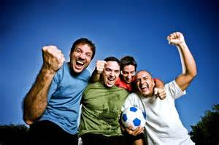
Physical Activity Recommendations
Stretching Recommendations
    Dynamic
    2-3 times per week all major groups
Daily Movement
    Taking the stairs
    Washing the car
    Walking to and from parking lot
    Working in the yard
    Walking the dog
Enjoy what you do!
  What did you enjoy as a kid?
Notes:
A regular stretching routine is just as important as your movement! It makes you less prone to injury, more mobile or fluid, and increase blood flow to the areas.
Daily movement – This is always good to mention. Daily movement is supplemental to a regular exercise routine.
It is so important to finding enjoyment in what you choose for movement. You will likely stick with it more an get more fulfillment.

Slide 30
Coping with Stress/Anxiety
Exercise, especially aerobic exercise
Don’t self-medicate
Limit Caffeine intake
Incorporate healthier foods
Manage sleep schedule- increase hours!
Try to savor moments
Relax and remember to have fun
Notes:
A regular stretching routine is just as important as your movement! It makes you less prone to injury, more mobile or fluid, and increase blood flow to the areas.
Daily movement – This is always good to mention. You will often hear “I

Slide 31

Noticing Some Commonalities?
See your doctor regularly – ask questions!
Manage your stress
Maintain a healthy weight
Eat a diet rich in fruits, vegetables, whole grains, and low-fat foods
Aim for quality sleep
Exercise for 20-30 minutes a day, 3-5 days/week
Seek help if you need it
Notes:
Some of the best approaches to helping men lead a healthier lifestyle and fuller life are simple steps!

Slide 32
Important Resources
Men’s Health Network
  www.MensHealthNetwork.com
Men’s Health Resource
  www.Men’shealthresourcecenter.com
Wear Blue for Men’s Health
  www.Wearblueformen.com
Prostrate Health Guide
  www.Prostratehealthguide.com
Men’s Health Library
  www.Menshealthlibrary.com
Notes:
Some of the best approaches to helping men lead a healthier lifestyle and fuller life are simple steps!

Slide 33


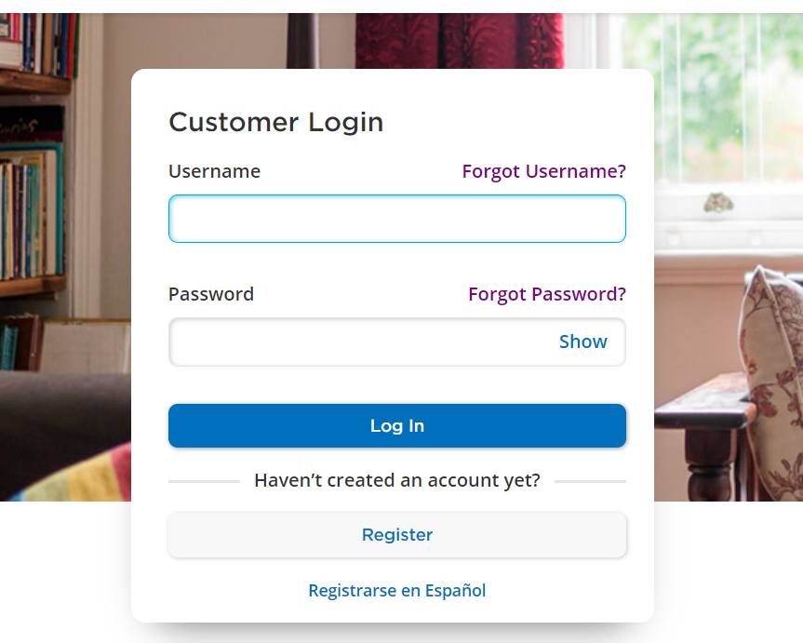
City of Fort Lauderdale’s Wellness Incentive Program (WIP)
Track your activities in your myCigna.com account
January 1 – December 31
The City is committed to employees good health and overall wellness. The goal of the voluntary Wellness Incentive Program (WIP) is to create a culture of health and wellness within the City of Fort Lauderdale by providing wellness-related activities throughout the year to encourage and engage employees in becoming happier and healthier at work and home.

Slide 34
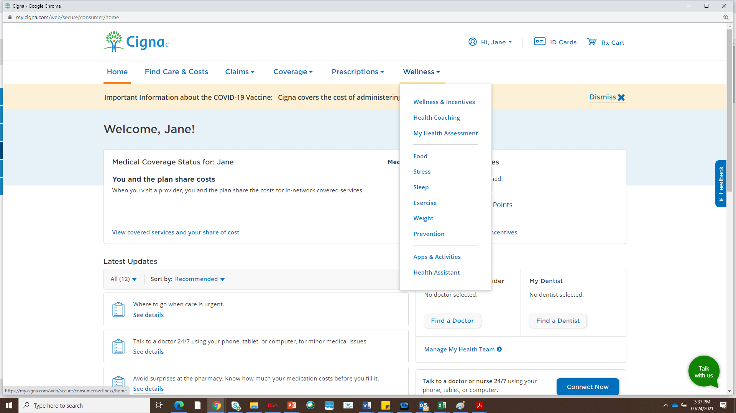
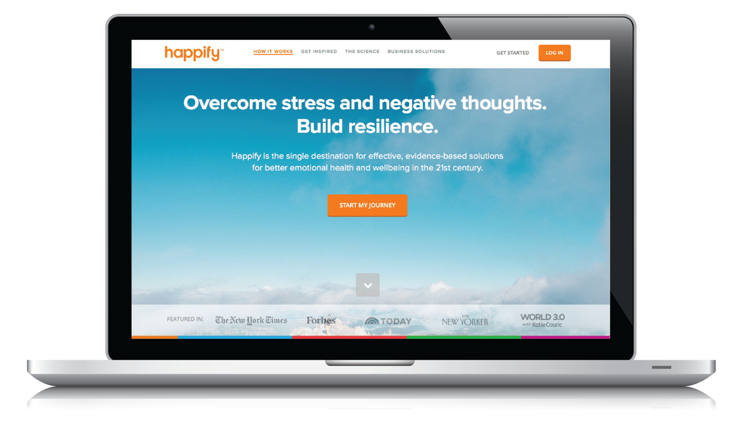
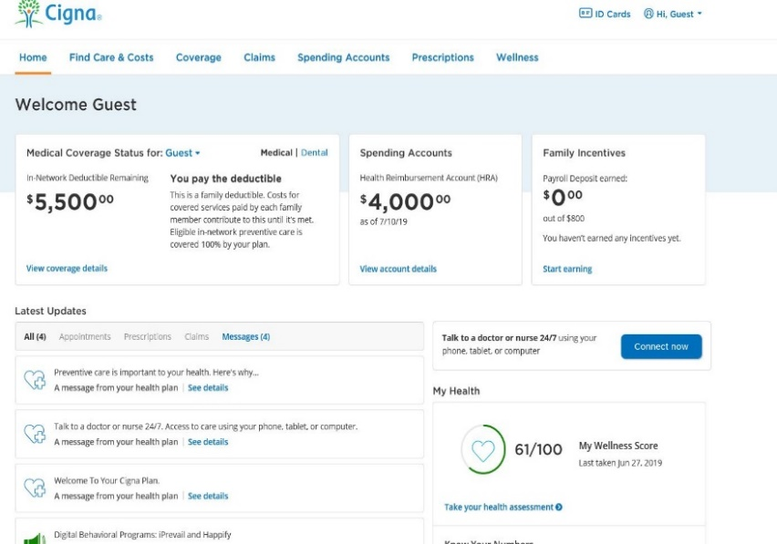

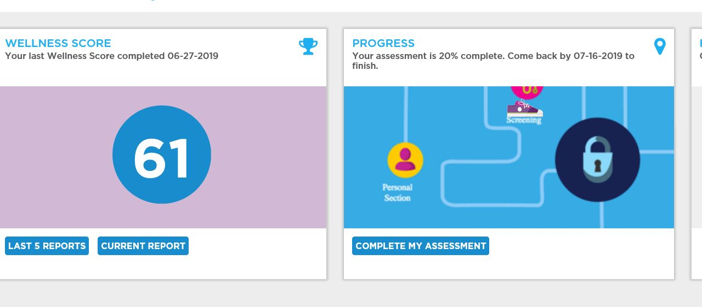
MotivateMe
®
Get all your health and wellness information in one place
REQUIRED GOAL
Images are subject to change.

Slide 35
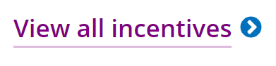
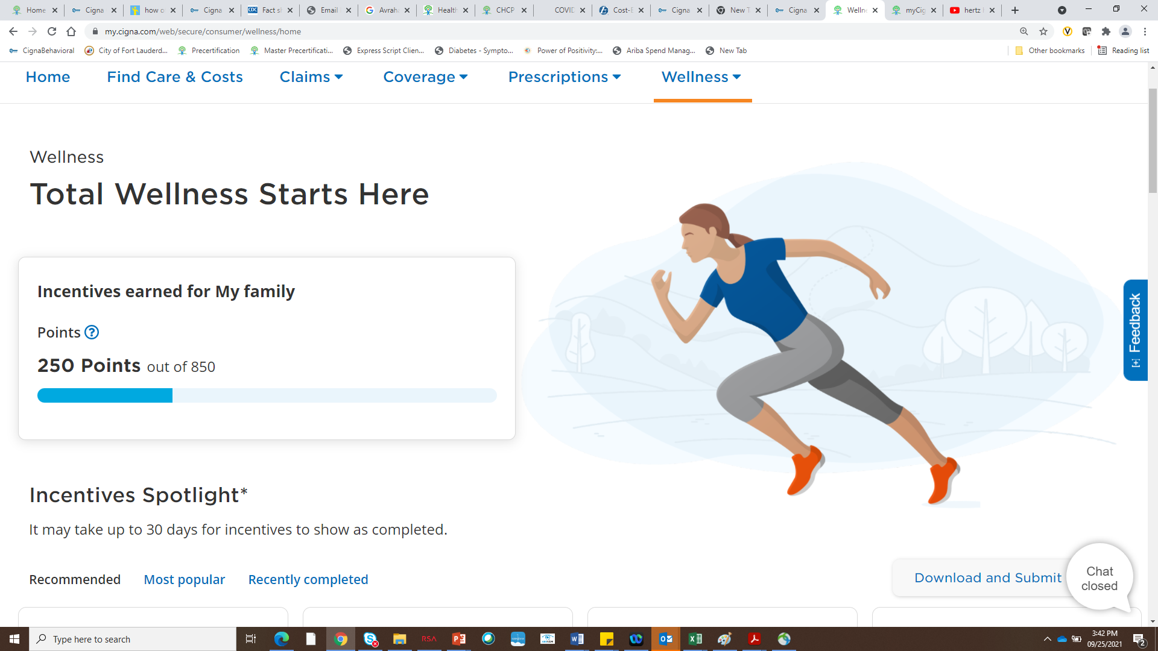
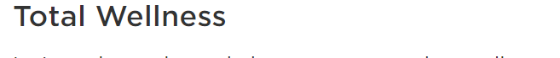
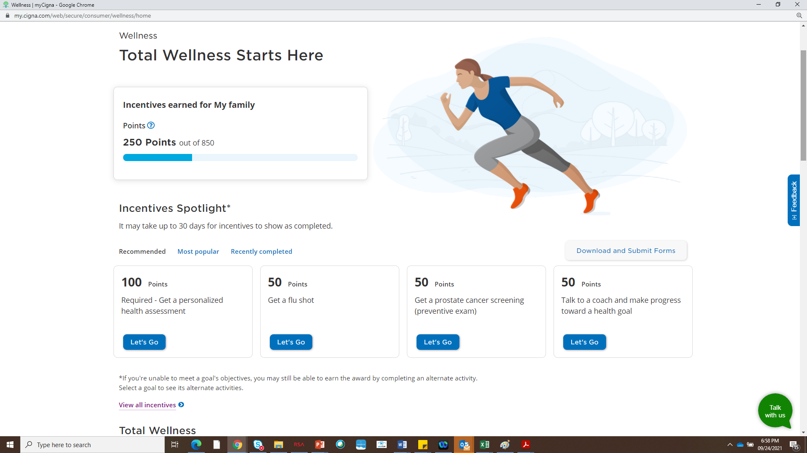
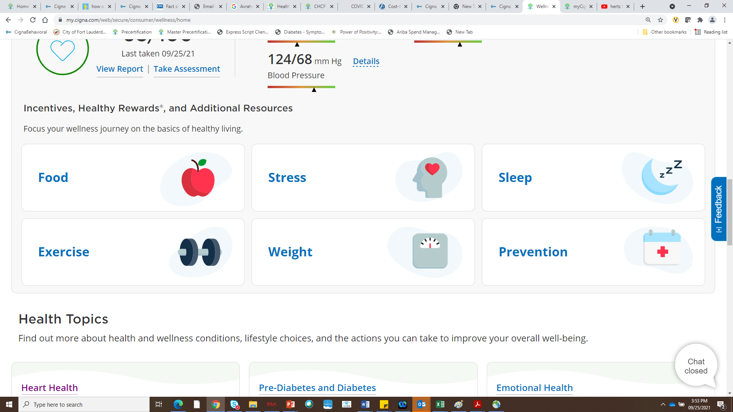
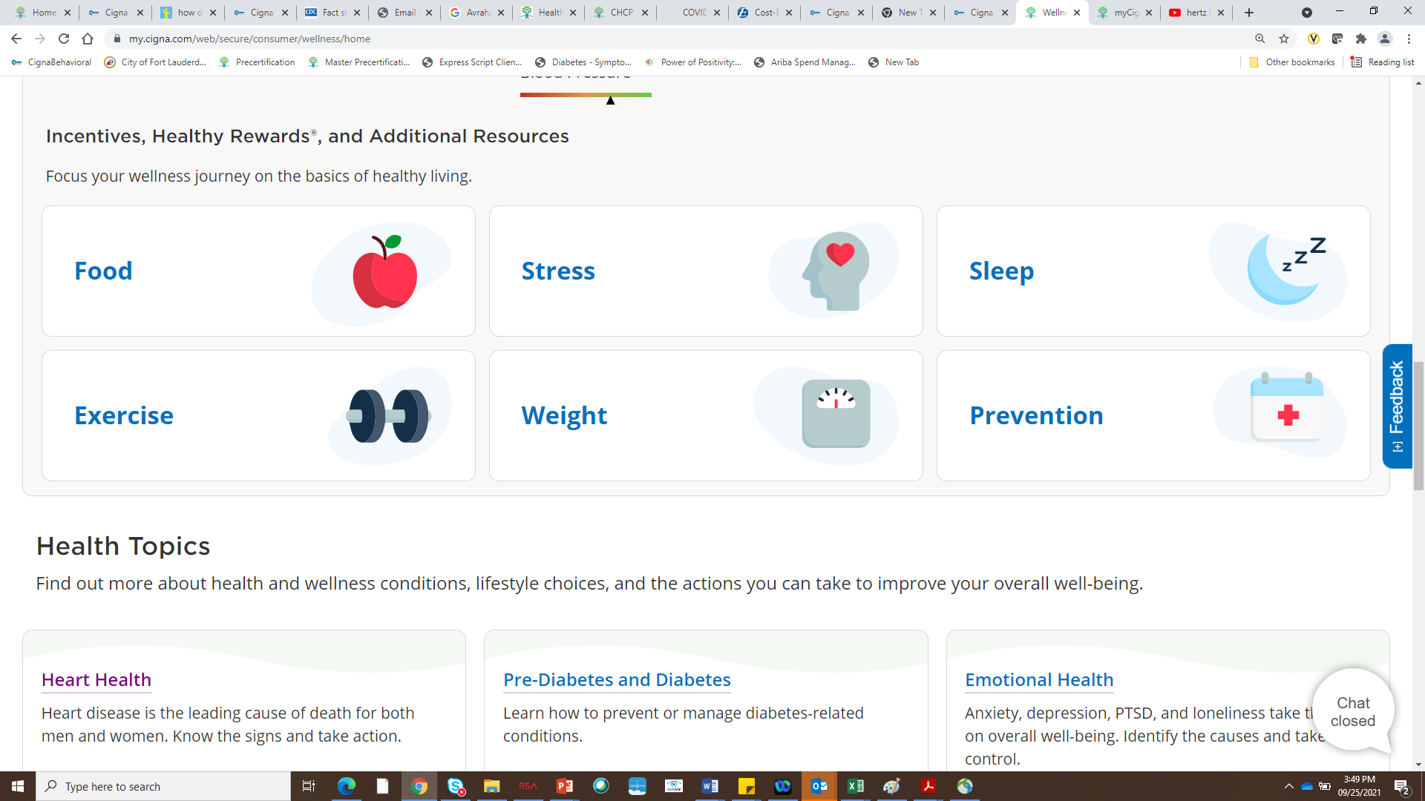
View all incentives

Slide 36
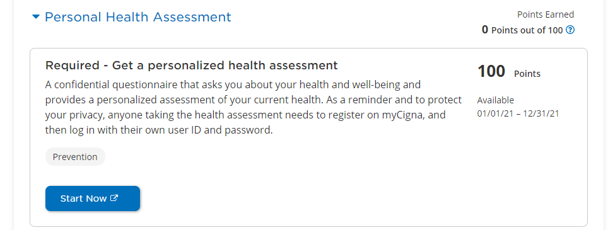
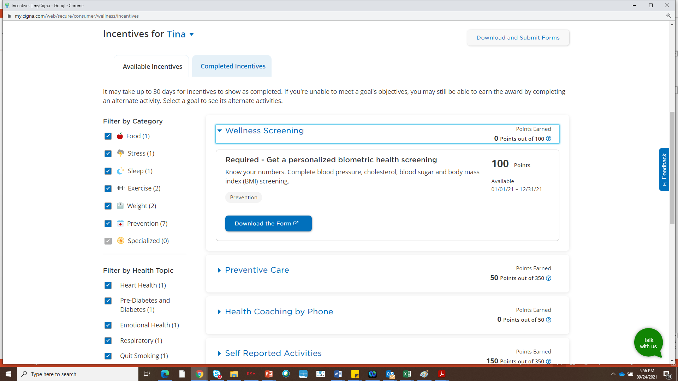
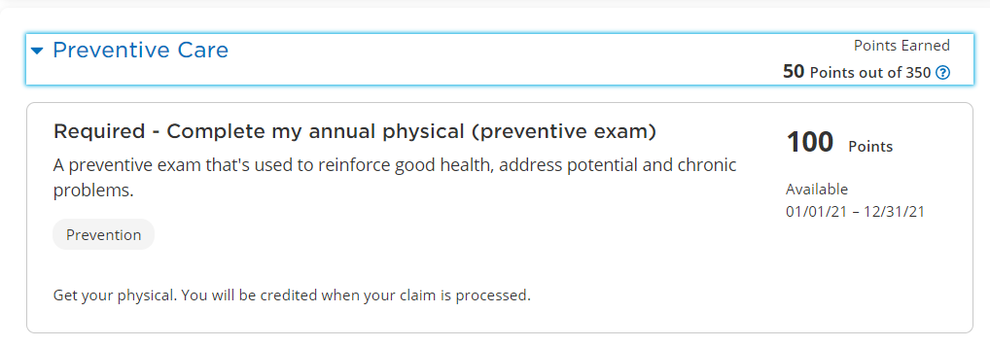
3 Required Goals
+ earn additional 200 points
Preventive Screenings or Health Coaching
Get a Flu Shot | 50 points
Complete Annual OB/GYN Exam | 50 points
Get a Mammogram* | 50 points
Get a Colon Cancer Screening* | 50 points
Get a Cervical Cancer Screening | 50 points
Get a Prostate Cancer Screening | 50 points
Talk to a Coach and Make Progress Toward a Health Goal (1 time per year) | 50 points
        No cost if the Affordable Care Act (ACA) guidelines are met and services are provided in-network.
        * These services are not performed at the City’s Health and Wellness Center.

Slide 37
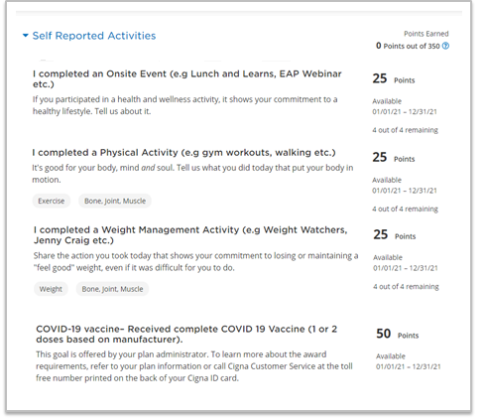
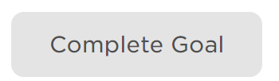
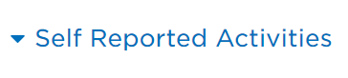
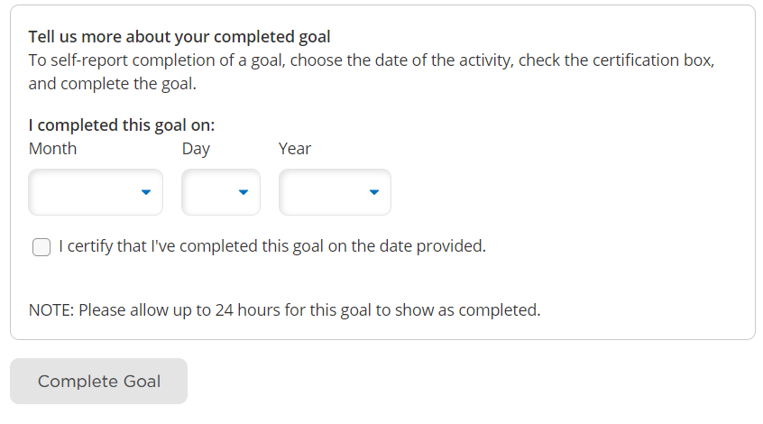
Add points in your portal before 12/31 (NO EXCEPTIONS)
˃Complete the 3 Required Goals and earn at least 200 points through preventive screenings, health coaching, or self-reported activities.
˃ Earn a (taxable) $500 incentive award for completing the voluntary program.

Slide 38


Cigna’s EmployeE Assistance Program (EAP)
Cigna’s EAP can connect you with a range of services, including emotional support, financial assistance, home/life support, and legal assistance.¹
Connect over the phone or through live chat, and receive a referral to licensed clinicians and consultants
Provides 10 Face to Face/Virtual sessions to connect with licensed clinicians in our EAP network
Meet with counselors virtually on your phone, tablet or home computer
Live, on-demand EAP webcasts
100% confidential
Available to anyone in your household
No additional cost to you
Call 1.877.622.4327
1. Employee assistance program services are in addition to, not instead of, your health plan benefits. These services are separate from your health plan benefits and do not provide reimbursement for financial losses. Customers are required to pay the entire discounted charge for any discounted legal and/or financial services. Legal consultations related to employment matters are excluded. Additional restrictions may apply. Program availability may vary by plan type and location, and are not available where prohibited by law.
38

Slide 39
Thank you!
Notes:
Biometric Health Screening -

