Slide 1
FINDING YOUR WAY TO FLOURISHING
Beating the “Blahs”
Presented by Your Employee Assistance Program

Slide 2
SEMINAR GOALS
Review the definitions of languishing and flourishing
Learn about core areas of our lives that contribute to flourishing
Explore targeted strategies for building up these areas
Understand how to use behavioral activation as a tool to get energized
Know the benefits of your Employee Assistance Program (EAP)

Slide 3
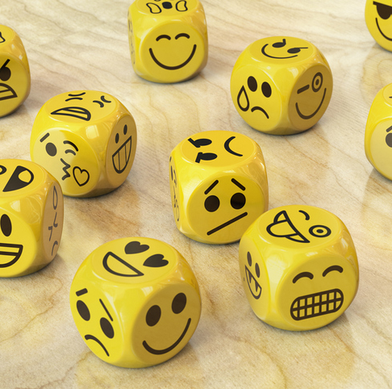
THE SPECTRUM OF MENTAL WELLNESS
X
X
Aimless
Apathetic
Flat
Unsettled
Indifferent
“Meh”
Bored
Fatigued
Unmotivated
Numb
Purposeful
Motivated
Cheerful
Content
Passionate
Healthy
Thriving
Energized
Good humored
Happy
(Ackerman, 2021)

Slide 4
THE SPECTRUM OF MENTAL WELLNESS
LANGUISHING
The absence of feeling good about your life; a lack of meaning, purpose, or belonging which leads to emptiness, lack of emotion and stagnation
- Corey Keyes, sociologist
FLOURISHING
The state of being free from illness and distress but, more important, of being filled with vitality and functioning well in one’s personal and social life
- American Psychological Association
Aimless
Apathetic
Flat
Unsettled
Indifferent
“Meh”
Bored
Fatigued
Unmotivated
Numb
Recent polls find that about 1 in 5 adults in the United States have reported symptoms of languishing during the COVID-19 pandemic.
Keyes, as cited by Young & McMahon, 2021; Gillette, 2021)

Slide 5
FINDING YOUR WAY TO FLOURISHING
Mental and physical well-being
Taking care of mind and body
Social connections
Cultivating support
Purpose and meaning
Working towards meaningful goals
Life satisfaction
Maximizing positive emotions

Slide 6
TAKING CARE OF THE MIND
Acknowledge, accept, and express emotions (even the negative ones)
Learn to re-direct your attention
Know your limits
Reach out for support
Mental health is a state in which we can realize our abilities and use them to cope with stressors, work productively, and make contributions to our community.
(HHS, 2022)
Notes:
6

Slide 7
TAKING CARE OF THE BODY
Sleep renews mental and physical resources
Exercise can boost your mood, sense of purpose
Mind the brain/gut connection with a healthy diet
Studies show that “mini-workouts” of 10 minutes or less throughout the day has the same benefits to our health and mood as longer, continuous workouts.
(Lindberg, 2021)
Notes:
7

Slide 8
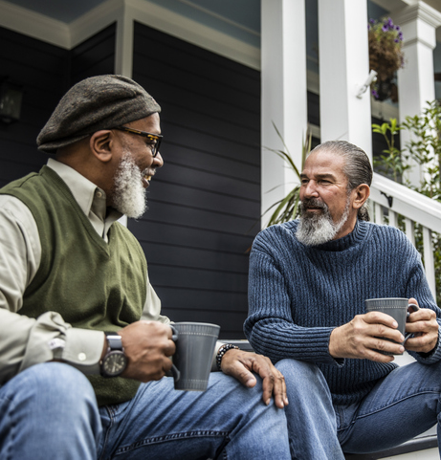
SOCIAL CONNECTIONS
Practice small talk
Look for opportunities to interact that incorporate your interests or hobbies
Use social media to your advantage
Enrich existing relationships
Research shows that even brief eye contact with another person increases our sense of inclusion and belonging.
(Nicolaus, 2019)

Slide 9
PURPOSE AND MEANING
Make rituals out of routines
Turn your dreams into achievable goals
Engage in activities that put you “in flow”
Craft your job to be meaningful to you
Job crafting entails adjusting your work tasks, relationships, and perspective in a way that incorporates your passions, strengths, and motivations.
(Dutton & Wrzesniewski, 2020)

Slide 10
HAPPINESS AND LIFE SATISFACTION
Practice gratitude
Savor, celebrate small moments
Be kind to others
Put your character strengths to use
Prosocial activities like volunteering trigger uplifting neurotransmitters in our brains that lift our mood and lower stress hormones.
(Cleveland Clinic, 2020)
Notes:
10

Slide 11
A COMPREHENSIVE APPROACH
Get out in nature
Practice time management
Keep in mind the spectrum of “health”: financial, spiritual, intellectual
Mindfulness meditation
These strategies have been shown to positively impact several of the core areas of flourishing covered in today’s seminar.
Notes:
11

Slide 12
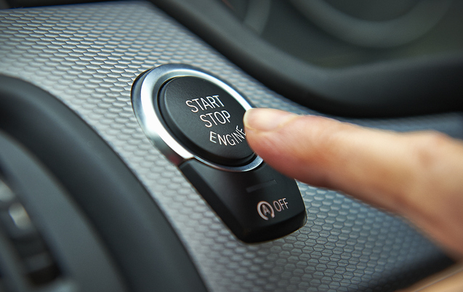
HOW DO I GET STARTED?
Behavioral activation:
By deliberately performing certain actions or behaviors, in spite of a lack of desire or motivation, you can “activate” a more positive emotional state.
“You shift the focus to getting started with what you have planned in front of you, taking your feelings, whatever they may be, along for the ride.”
- Brad Stulberg
(Villines, 2021; Stulberg, 2022)

Slide 13
BEHAVIORAL ACTIVATION BASICS
1. Notice
Note the connection between what you do and how you feel
2. Evaluate
Determine what is valuable for you right now
3. Take action
Set a micro-goal: gradual, small steps toward a larger goal

Slide 14
SETTING MICRO GOALS TOWARDS FLOURISHING
Mental well-being
Sit outside or by an open window for 10 minutes
Physical well-being
Put on workout clothes, shoes, etc.
Social connections
Send one personal note, text, IM, or call per day
Purpose and meaning
Create a daily ritual around an everyday task
Life satisfaction
Snap a photo of one thing each day you enjoyed

Slide 15
GIVE YOURSELF THE MOST IMPORTANT GIFTS
Permission… to feel how you feel in the midst of ongoing challenges
Space… to take steps in your own way, at your own pace
Acceptance… of imperfection, of what may seem like “slow” progress
Kindness... reminding yourself that what seems “simple” isn’t always easy

Slide 16
Face-to-face sessions
Confidential
Prepaid
Unlimited telephonic consultation
Available 24 hours a day, 7 days a week
Household benefit
Work/life support such as elder care, child care and pet care
Convenience services
Financial services
Legal services
1-877-622-4327
BENEFITS OF THE EAP
Benefits vary by employer. Please check with your HR for your specific EAP benefits.

Slide 17
REFERENCES
American Psychological Association (APA) (n.d.) Flourishing definition. https://dictionary.apa.org/flourishing
American Psychological Association (APA) (2021, March) Speaking of Psychology: How meditation can help you live a flourishing life, with Richard Davidson, PhD [podcast]. https://www.apa.org/news/podcasts/speaking-of-psychology/meditation
Ackerman, C.E. (2021, July 12) Flourishing in Psychology: Definition + 8 Practical Tips. PositivePsychology.com. https://positivepsychology.com/flourishing/
Cassetty, S. (2021, November 15) Can you eat your way to better mental health? A dietitian explains. Today. https://www.today.com/health/do-you-want-feel-happier-here-s-what-foods-eat-t239008
Cleveland Clinic. (2020, October 28). Why giving is good for your health. Retrieved from https://health.clevelandclinic.org/why-giving-is-good-for-your-health/
Dutton, J.E. & Wrzesniewski, A. (2020, March 12) What Job Crafting Looks Like. Harvard Business Review. https://hbr.org/2020/03/what-job-crafting-looks-like
Fulton, B. (2020, October 27) The Benefits of Gratitude and How to Get Started. Healthline. https://www.healthline.com/health/benefits-of-gratitude-practice
Gillette, H. (2021, June 24) Are You Languishing? These Are the Signs and What to Do. PsychCentral. https://psychcentral.com/depression/what-is-languishing
Gloster AT, Lamnisos D, Lubenko J, Presti G, Squatrito V, Constantinou M, Nicolaou C, et al. (2020) Impact of COVID-19 pandemic on mental health: An international study. PloS One, 15(12). https://doi.org/10.1371/journal.pone.0244809
Gould, W.R. (2021, November 11) The Dangers of Bottling Up Our Emotions. VeryWell Mind. https://www.verywellmind.com/the-dangers-of-bottling-up-our-emotions-5207825
Grant, A. (2021, April 19) There’s a Name for the Blah You’re Feeling: It’s Called Languishing. New York Times. https://www.nytimes.com/2021/04/19/well/mind/covid-mental-health-languishing.html
Notes:
17

Slide 18
REFERENCES
Lindberg, S. (2021, September 22) Fit It In: Mini Workouts Are a Great Option When You’re Crunched for Time. Healthline. https://www.healthline.com/health/fitness/fit-it-in-mini-workouts
Nicolaus, P. (2019, July 26) Want to Feel Happier Today? Try Talking to a Stranger. National Public Radio. https://www.npr.org/sections/health-shots/2019/07/26/744267015/want-to-feel-happier-today-try-talking-to-a-stranger
Reynolds, G. (2021, May 17) How Exercise May Help Us Flourish. New York Times. https://www.nytimes.com/2021/05/12/well/move/exercise-mental-health-flourishing.html
Santos, L. (n.d.) Things We Think Will Make Us Happy (But Don’t) [Online course lecture]. The Science of Well-Being, https://www.coursera.org/learn/the-science-of-well-being
Stulberg, B. (2022, February 13) You’ve Done Self Care. You’ve Languished. Now Try This. New York Times. https://www.nytimes.com/2022/02/13/opinion/culture/pandemic-languishing-behavioral-activation.html
U.S. Department of Health and Human Services (HHS) (2022, February 28) What is Mental Health? https://www.mentalhealth.gov/basics/what-is-mental-health
VanerWeele, T.J. (2020) Activities for Flourishing: An Evidence-Based Guide. Journal of Positive Psychology & Wellbeing, 4(1), pp. 79-91. https://hfh.fas.harvard.edu/files/pik/files/activitiesforflourishing_jppw.pdf
Villines, Z. (2021, October 24) What is behavioral activation? Medical News Today. https://www.medicalnewstoday.com/articles/behavioral-activation
Watson, S. & Cherney, K. (2021, December 15) The Effects of Sleep Deprivation on Your Body. https://www.healthline.com/health/sleep-deprivation/effects-on-body
Wier, K. (2020, April 1) Nurtured by Nature. American Psychological Association. https://www.apa.org/monitor/2020/04/nurtured-nature
Young, R. & McMahon, S. (2021, May 04) Living, But Not Flourishing: The Pandemic-Fueled Feeling Known as ‘Languishing.’ WBUR. https://www.wbur.org/hereandnow/2021/05/04/languishing-pandemic-mental-health
Notes:
18

Slide 19
All Cigna products and services are provided exclusively by or through operating subsidiaries of Cigna Corporation. All pictures are for illustrative purposes only.
921150 04/22 © 2022 Cigna. Some content provided under license.

