Slide 1
Healthy Eating for the Holidays
Dr. Lloyd Bridges
Marathon Health
Notes:
An extra busy week with work or traveling out of town does not have to mean forfeiting your health to a diet of fast food.

Slide 2
Disclaimer
The content of this presentation, including any handouts, is for educational and/or informational purposes only and is not intended to be a substitute for professional advice, diagnosis or treatment. Always seek the advice of a qualified professional with any questions or concerns you may have.

Slide 3
Objectives for this presentation:
Optimal Health and Nutrition – where do we begin?
Goal of Optimal Nutrition - solutions to avoid fad diets
Macronutrients
Mediterranean diet and concepts
Strategies for eating healthy at holiday social events
Quick, on-the-go food options

Slide 4
Running with Horses

Slide 5
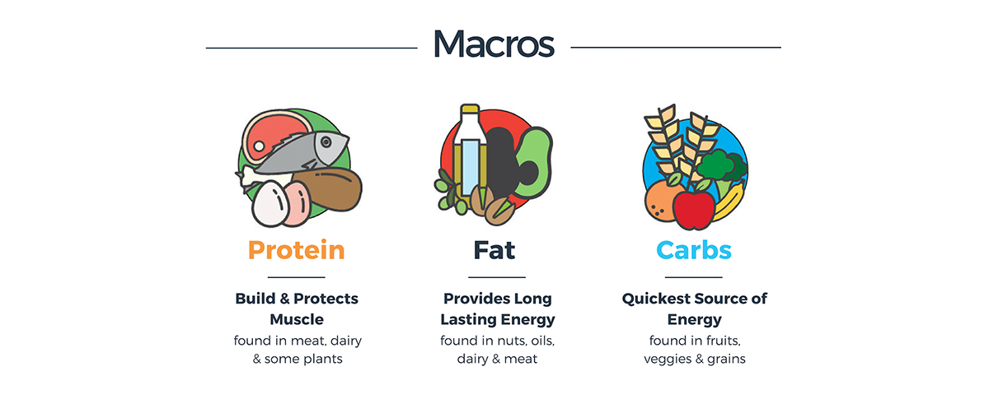
Macronutrients
Macronutrients are the nutrients our bodies need in large amounts. You need all three macronutrients as a part of a healthy diet, so you shouldn’t exclude or restrict any of them
They provide energy and are often called “macros”
There are three macronutrients
Carbohydrates
Proteins
Fats

Slide 6
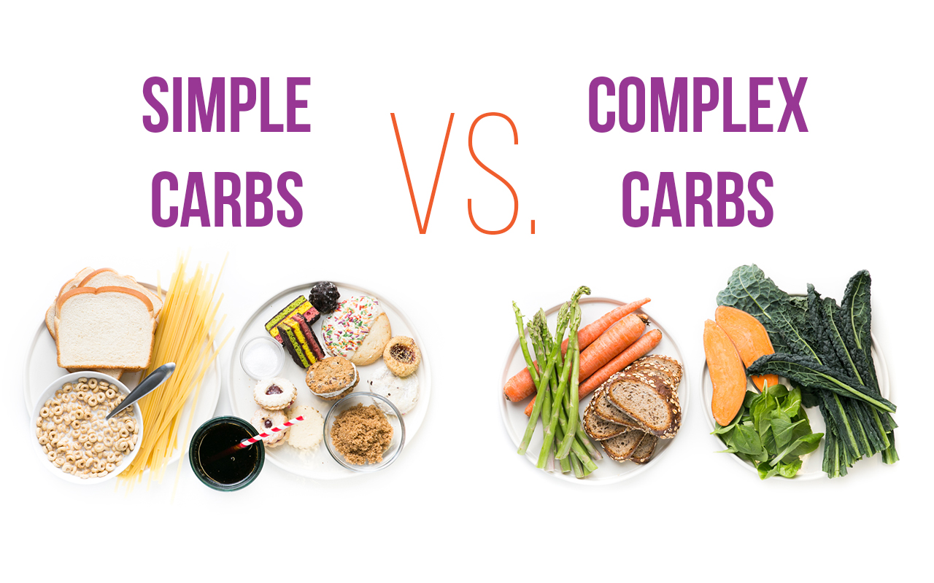
Carbohydrates
Carbohydrates or carbs are sugar molecules
Carbohydrates breakdown into glucose or blood sugar
Glucose or blood sugar is the main source of energy for your body’s cells, tissues, and organs
Glucose can be used immediately or stored in the liver and muscles for use later on
Simple Carbs
Complex Carbs

Slide 7
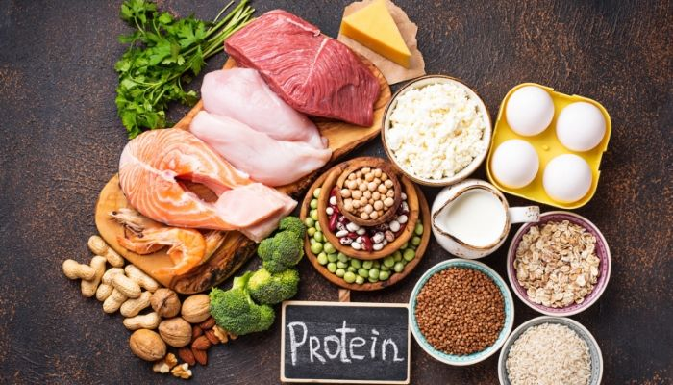
Proteins
Proteins are an essential macronutrient
Protein is made from basic building blocks called amino acids
Plays an essential role in growth, development and repair of the body
Animal proteins
Meat, fish, dairy, and eggs
Plant based proteins
Beans, grains, nuts, and soy

Slide 8
Fats
Fats are the most calorie rich macro-nutrient
They are essential to normal body functions – insulation for nerves, skin/hair health, backbone to hormones
Types of fats
Monounsaturated fats
Polyunsaturated fats
Saturated fats
Trans fats

Slide 9
FAD Diets
FAD diets are often sold as the quickest and best solution to loose weight
Most involve eliminating foods that contain necessary nutrients that your body needs to maintain good health
All involved some type of restriction
Foods
Timing
How to spot a FAD diet
Proposes a quick fix versus a lifestyle
Recommendations based on a single study
Elimination of one or more of the five food groups

Slide 10
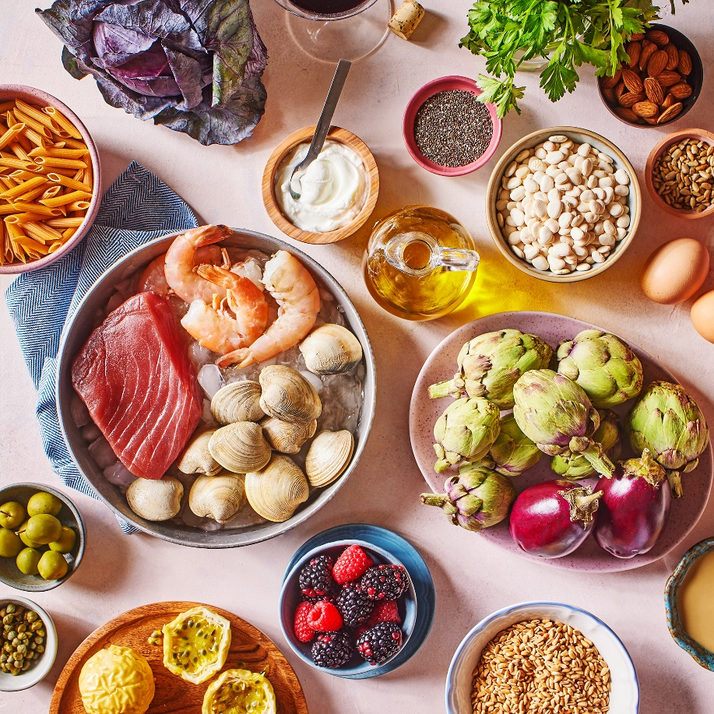
Mediterranean Diet
Rich in flavorful ingredients like fruits, vegetables, whole grains, and heart-healthy fats, the Mediterranean diet is equal parts delicious and nutritious
It’s also associated with a variety of benefits
May help support brain function
Promote heart health
Regulate blood sugar levels

Slide 11
Mediterranean Diet
Vegetables: tomatoes, broccoli, kale, spinach, onions, cauliflower, carrots, Brussels sprouts, cucumbers, potatoes, sweet potatoes, turnips
Fruits: apples, bananas, oranges, pears, strawberries, grapes, dates, figs, melons, peaches
Nuts, seeds, and nut butters: almonds, walnuts, macadamia nuts, hazelnuts, cashews, sunflower seeds, pumpkin seeds, almond butter, peanut butter
Legumes: beans, peas, lentils, pulses, peanuts, chickpeas
Whole grains: oats, brown rice, rye, barley, corn, buckwheat, whole wheat bread and pasta
Fish and seafood: salmon, sardines, trout, tuna, mackerel, shrimp, oysters, clams, crab, mussels
Poultry: chicken, duck, turkey
Eggs: chicken, quail, and duck eggs
Dairy: cheese, yogurt, milk
Herbs and spices: garlic, basil, mint, rosemary, sage, nutmeg, cinnamon, pepper
Healthy fats: extra virgin olive oil, olives, avocados, and avocado oil

Slide 12
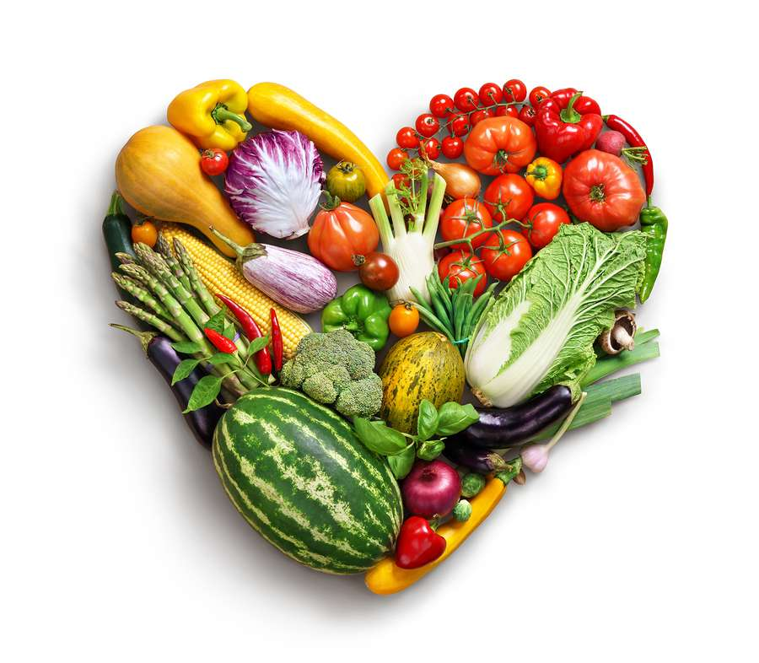
Key Principles for Optimal Nutrition
Balance, variety, and moderation of all macronutrients
Carbs are our main energy source to regulate our glucose
Do not overconsume red meat and other animal based protein
Monounsaturated fats are preferred over saturated/trans fats
Drink a sufficient amount of water each day

Slide 13
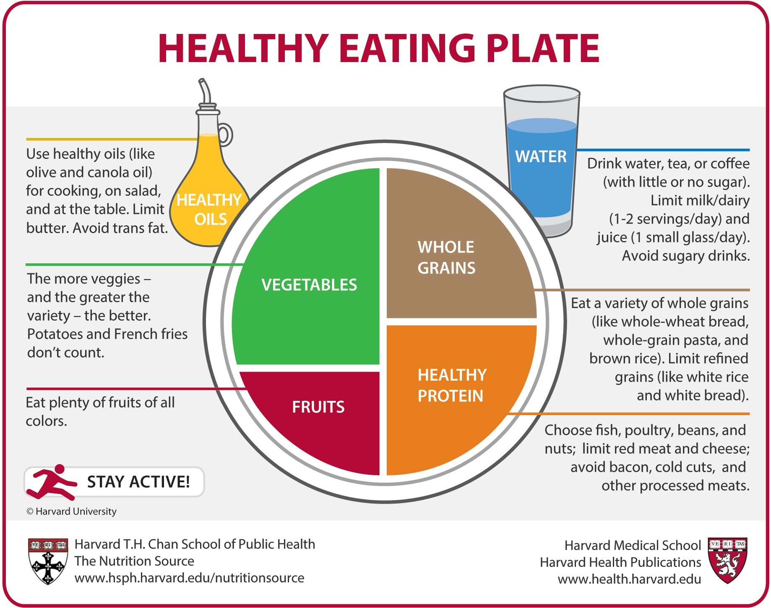
Notes:
https://www.hsph.harvard.edu/nutritionsource/healthy-eating-plate/

Slide 14
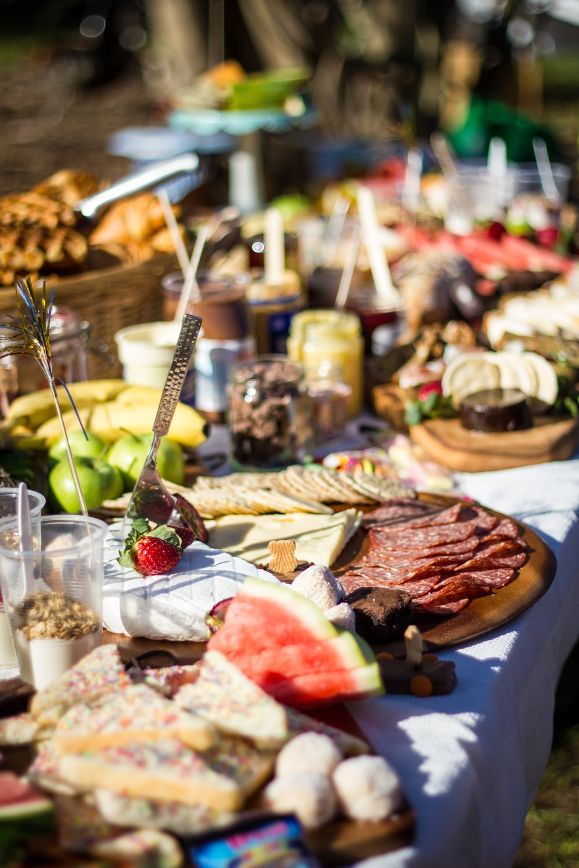
Strategies for Success at Holiday Events
Pitch In
Bring options to the party that you know are healthier
Eat before you go
Know your options
Before you put anything on your plate, see what all your options are first
Focus on the fruits and veggies
Fill up on produce first
If you go back for seconds, aim to stick with fruits & veggies
Chew gum or have a mint!
Once you have had one pass at the food, pop in a mint to avoid mindless snacking
Drink water
Don’t stand near the food
Notes:
you don’t want to be so ravenous that you just start eating everything in sight. When we are hungry we tend to make poor food choices (it’s the same reason why we tell people not to go to the grocery store hungry). Eat a snack before you go. An apple is a great snack because it’s portable and has lots of fiber to help fill you up.
As you look over the offerings, take note of everything that’s available and start to decide what you’ll eat and how much.

Slide 15
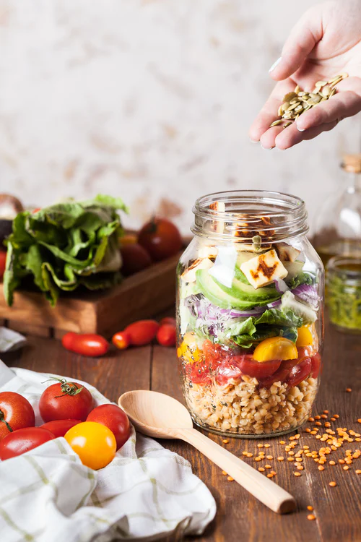
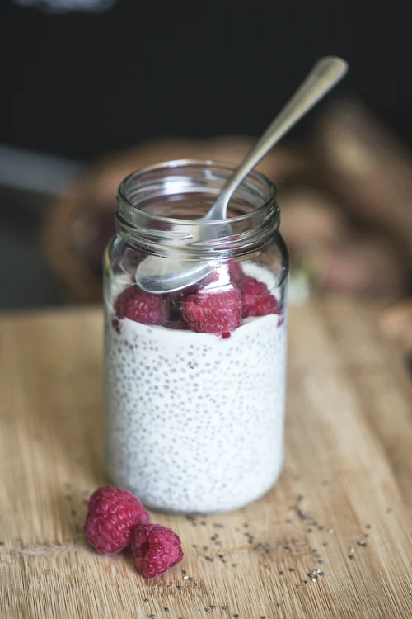
Quick Food Options
Food choices to grab when pressed for time. Good options to potentially keep in hotel room, bring to the office for lunch, or on days when you lack time at home:
Rotisserie chicken and bagged salad
Tuna can or pouch
Hard boiled eggs
Turkey sandwich
“protein packs”: nuts, cheese, fruit, veggies
Greek yogurt with fruit and nuts
Fruit
Single serve peanut butter
Sheet pan recipes using precut or frozen veggies and protein

Slide 16
Questions?

Slide 17
Schedule a Provider or Health Coach Visit
CALL: 754-206-2420

Slide 18
References
Penn State News. (2007). Eating soup will help cut calories at meal. http://news.psu.edu/story/196394/2007/04/25/eating-soup-will-help-cut-calories-meal
Prevent type 2 diabetes. Centers for Disease Control and Prevention. https://www.cdc.gov/diabetes/prevent-type-2/index.html. Published July 15, 2021. Accessed August 4, 2021.
Urban, L. E., Weber, J. L., Heyman, M. B., Schichtl, R. L., Verstraete, S., Lowery, N. S., Das, S. K., Schleicher, M. M., Rogers, G., Economos, C., Masters, W. A., & Roberts, S. B. (2016). Energy Contents of Frequently Ordered Restaurant Meals and Comparison with Human Energy Requirements and U.S. Department of Agriculture Database Information: A Multisite Randomized Study. Journal of the Academy of Nutrition and Dietetics, 116(4), 590–8.e6. https://doi.org/10.1016/j.jand.2015.11.009
Zargar, S. (n.d.). 5 easy bento BOX lunches for KIDS: San DIEGO Pediatricians: Children's primary Care Medical Group. San Diego Pediatricians | Children's Primary Care Medical Group. https://www.cpcmg.net/5-easy-bento-box-lunches-for-kids/.
https://www.nhlbi.nih.gov/health/educational/wecan/downloads/tip-portion-size.pdf
https://www.hsph.harvard.edu/nutritionsource/healthy-eating-plate/

